Slide 1
Goomy`s adventure
By Sarah Hobaish ^>^ :3

Slide 2
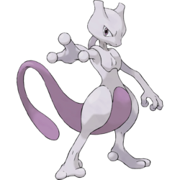
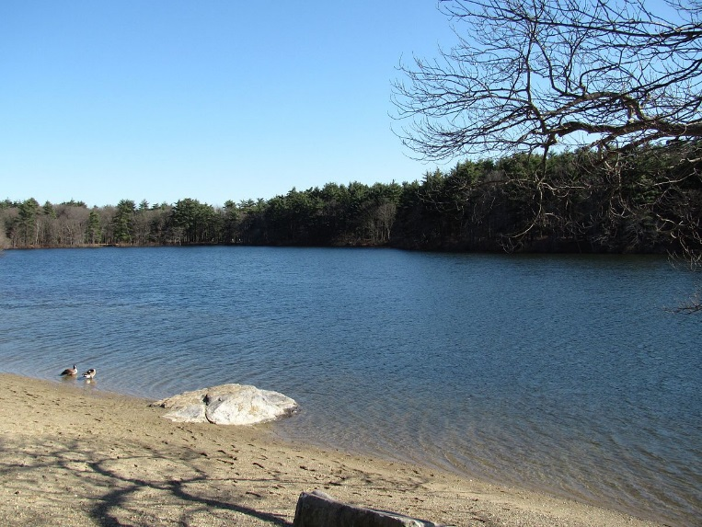
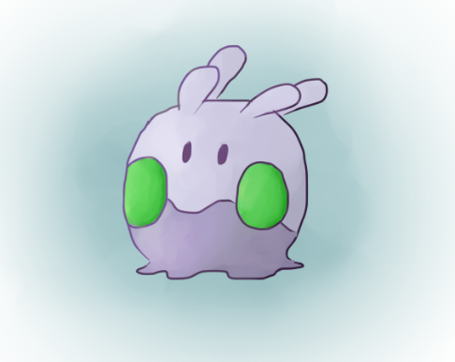
There was once a slimy,slippery Goomy
Goomy lived in a beautiful pond with lots of other pokemon!But one day many pokemon invaded the pond and their leader was a very sinister Mewtwo, that Mewtwo would attack any of it`s allies if they disobeyed it. Goomy was very scared, Goomy took a few pokemon with it as it escaped the danger. Goomy swore to come back and help win back the pond. But as they escaped a evil Raticate saw them and followed them. It attacked, Goomy and it`s friends were scared.

Slide 3
What should they do?????? ☹ ☹ ☹ ☹☹
Fight Bravely
Stay but don’t Fight
Give up and come back to the pond
Run Away

Slide 4
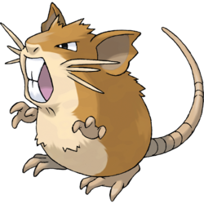
Fight Bravely
Goomy and its friends risked it and fought bravely, the fight was tought and Goomy had taken strong hits but Goomy used bide and Raticate fainted. Goomy and its friends trained hard evolved and got the pond back.

Slide 5
Run Away
They ran deep in the forest, Mewtwo found them and they fainted.
GAME OVER
Try again? (click first slide to try again)
First Slide

Slide 6
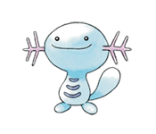
Stay but don’t Fight
Goomy and its friends stayed put but never fought, Raticate lost intrest in them and walked away bored. They evolved one day and got the pond back

Slide 7
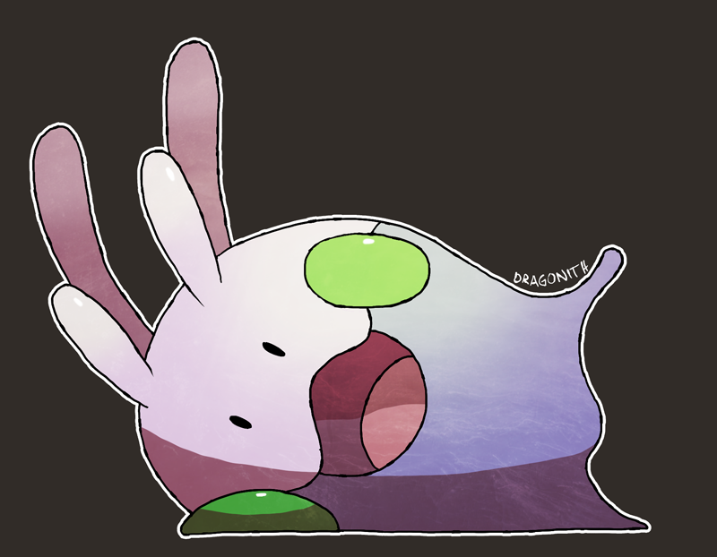
Give Up and come back to the pond
Goomy and its friends went back to the pond and fainted weakly
First Slide click first slide to restart

